Slide 1
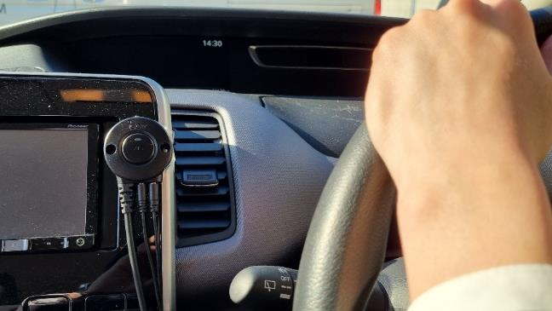
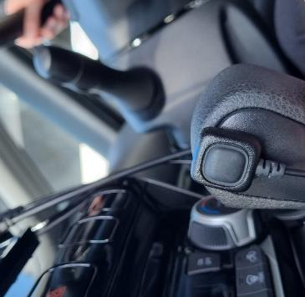
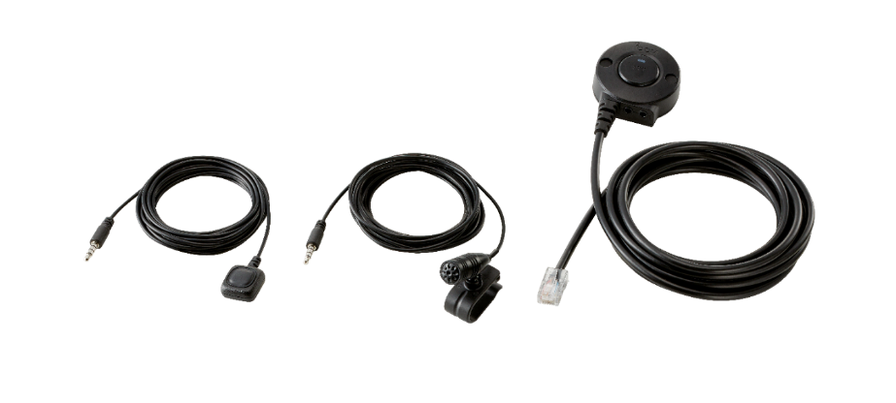
February 1 st, 2023
Vol.030
Hands-free Microphone : HM-249
The HM-249 is a new accessary for hands-free user operation in vehicles when using a mobile radio. It is a simple solution for the increasingly global trend of hands-free operation enforcement for any type of communication devices including professional radios (PTT device). We recommend this to all of your customers which use mobile radios in vehicles.
Supplied Accessory
Small PTT button with 2.5m connection cable : Attach to car transmission gear or place it the near the steering wheel
Microphone with 2.5 m connection cable : Attach to the car sun visor etc.
Big PTT switch button : Has an RJ-45 type modular microphone connector, to connect with mobile radios microphones jack
Small PTT Button
Microphone
Big PTT Swith Button

Slide 2
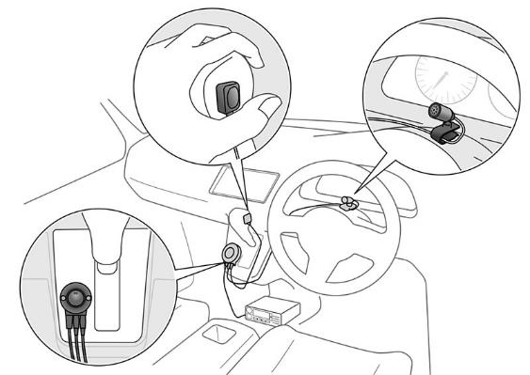
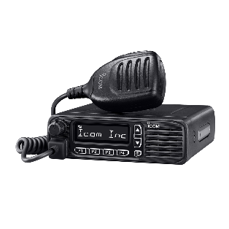
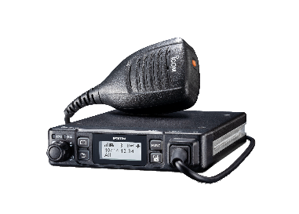
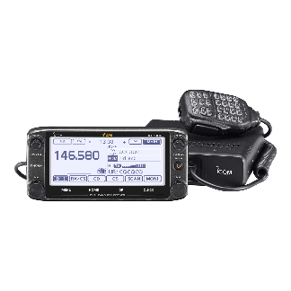
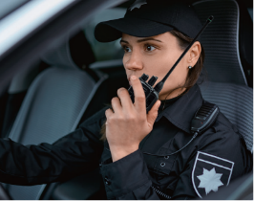
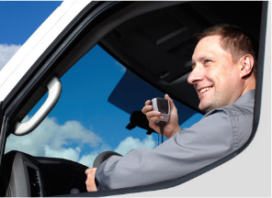
The HM-249 installation is very easy. Each PTT and Microphone has a seal (3M type) on back side, to let you attach it to your desired position. The big PTT Switch Button also has a screw hole for a solid attachment.
IC-F5130D/F6130D
IP501M
ID-5100 etc
*Please attach each accessary to the position does not
influence to your driving operation in vehicles.
Just as a reminder! We have released great new mobile radios too!
IC-F5130D/F6130D
New Generation Entry Level Mobile Radio, replacement model of IC-F5120D series. Improved visibility with high contrast and wide viewing analog black background LCD.
IC-F5330D/F6330D
Black box type IDAS Digital/ Analogue RF radio with Command Mic. Loud and intelligible audio even in nosy environments. Flexible installation using unique PoE technology, that can be extended up to 100m, 328 ft from the radio.
*IC-F5330D/F6330D cannot use with HM-249 because need Command Mic.
We also want to get your next order for each mobile radios!!

